Slide 1
Reasoning
http://compcogscisydney.org/psyc2071/
Danielle Navarro

Slide 2
Deductive reasoning
Inductive reasoning
Informal reasoning

Slide 3
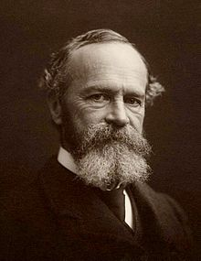
“WE talk of man* being the rational animal; and the traditional intellectualist philosophy has always made a great point of treating the brutes as wholly irrational creatures.
Nevertheless, it is by no means easy to decide just what is meant by reason”
- William James (1890)

Slide 4
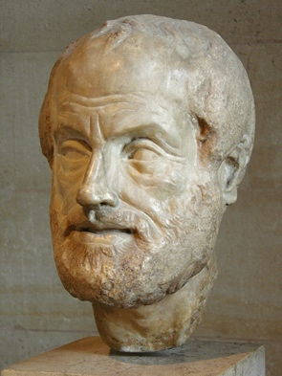

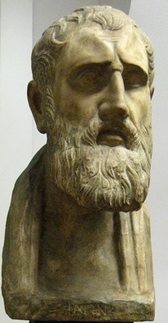
Reasoning, logic and truth
Aristotle
Philo
Zeno
How is the truth of a claim established?
What should we believe?
Are there rules we should follow?
What are these rules?
(And do we follow them?)
… and the peripatetics
… and the dialecticians
… and the stoics
http://plato.stanford.edu/entries/logic-ancient/

Slide 5
Kinds of reasoning
Using facts to reach a “logically certain” conclusion
Deductive reasoning

Slide 6
Kinds of reasoning
Using facts to reach a “logically certain” conclusion
Deductive reasoning
Using facts to reach a “plausible” conclusion (allows room for doubt)
Inductive reasoning

Slide 7

Part 1:
Deductive reasoning

Slide 8
“Syllogisms” are a tool for formalising arguments
All men* are mortal
Socrates is a man
Therefore, Socrates is mortal
(* With very sincere apologies to everyone for the sexist framing here – this specific phrasing has a long history)

Slide 9
The major premise states a general rule
All men* are mortal
Socrates is a man
Therefore, Socrates is mortal

Slide 10
The major premise states a general rule
The minor premise states a specific fact
All men* are mortal
Socrates is a man
Therefore, Socrates is mortal

Slide 11
The major premise states a general rule
The minor premise states a specific fact
All men* are mortal
Socrates is a man
Therefore, Socrates is mortal
The conclusion is the statement we are asked to accept

Slide 12
A slight variation on this argument
If Socrates is a man, then he is mortal
Socrates is a man
Therefore, Socrates is mortal

Slide 13
Major premise:
Antecedent: “Socrates is a man”
Consequent: ”Socrates is mortal”
If Socrates is a man, then he is mortal
Socrates is a man
Therefore, Socrates is mortal

Slide 14
Major premise:
Antecedent: “Socrates is a man”
Consequent: ”Socrates is mortal”
If Socrates is a man, then he is mortal
Socrates is a man
Therefore, Socrates is mortal
No changes to the minor premise or the conclusion

Slide 15
If Socrates is a man, then he is mortal
Socrates is a man
“Affirming” evidence refers to a fact (in the minor premise) that agrees with the major premise in some sense

Slide 16
If Socrates is a man, then he is mortal
Socrates is NOT a man
“Denying” evidence refers to a fact (in the minor premise) that disagrees with the major premise in some sense

Slide 17

Valid arguments:
Conclusion is necessarily true if the premises are true
i.e., it is impossible for the premises to be true and the conclusion to be false (at the same time)

Slide 18
Valid argument by affirmation…
(positive evidence)
 | Affirms | Denies
Antecedent | “Modus ponens” | Denying the antecedent
Consequent | Affirming the consequent | “Modus tollens”

Slide 19
Modus ponens
(“the way that affirms”)
If Socrates is a man, then he is mortal
Socrates is a man
Therefore, Socrates is mortal
Minor premise asserts that the antecedent of the major premise is TRUE

Slide 20
Modus ponens
(“the way that affirms”)
If Socrates is a man, then he is mortal
Socrates is a man
Therefore, Socrates is mortal
Mortals
This Venn diagram describes the structure of the major premise (*sort of)
Men

Slide 21
Modus ponens
(“the way that affirms”)
If Socrates is a man, then he is mortal
Socrates is a man
Therefore, Socrates is mortal
It’s impossible to put the x inside the “man circle” and outside the “mortal circle”
Mortals
Men
X
Socrates

Slide 22
Modus ponens
(“the way that affirms”)
If Socrates is a man, then he is mortal
Socrates is a man
Therefore, Socrates is mortal
Mortals
Men
X
Socrates

Slide 23
Valid argument by denial…
(negative evidence)
 | Affirms | Denies
Antecedent | “Modus ponens” | Denying the antecedent
Consequent | Affirming the consequent | “Modus tollens”

Slide 24
Modus tollens
(“the way that denies”)
If Socrates is a man, then he is mortal
Socrates is a NOT a mortal
Therefore, Socrates is NOT a man
Minor premise asserts that the consequent of the major premise is FALSE

Slide 25
Modus tollens
(“the way that denies”)
If Socrates is a man, then he is mortal
Socrates is a NOT a mortal
Therefore, Socrates is NOT a man
If Socrates is outside the mortal circle, then “he” can’t be inside the man circle
Mortals
Men
X
Socrates

Slide 26
Modus tollens
(“the way that denies”)
If Socrates is a man, then he is mortal
Socrates is a NOT a mortal
Therefore, Socrates is NOT a man
Mortals
Men
X
Socrates

Slide 27

Valid arguments:
Conclusion is necessarily true if the premises are true
i.e., it is impossible for the premises to be true and the conclusion to be false (at the same time)
Invalid arguments:
Conclusion might be true, but it is not guaranteed by the premises
i.e., it is possible for the premises to be true but the conclusion can still be false

Slide 28
Invalid argument by affirmation…
 | Affirms | Denies
Antecedent | “Modus ponens” | Denying the antecedent
Consequent | Affirming the consequent | “Modus tollens”

Slide 29
Affirming the consequent
If Socrates is a man, then he is mortal
Socrates is mortal
Therefore, Socrates is a man?
Minor premise asserts that the consequent of the major premise is TRUE

Slide 30
Affirming the consequent
If Socrates is a man, then he is mortal
Socrates is mortal
Therefore, Socrates is a man?
Socrates
Mortals
X
This is invalid because there are other things that are mortal without being men
Men

Slide 31
Invalid argument by denial…
 | Affirms | Denies
Antecedent | “Modus ponens” | Denying the antecedent
Consequent | Affirming the consequent | “Modus tollens”

Slide 32
Denial of the antecedent
If Socrates is a man, then he is mortal
Socrates is a NOT a man
Therefore, Socrates is NOT a mortal?
Minor premise asserts that the antecedent of the major premise is FALSE

Slide 33
Denial of the antecedent
If Socrates is a man, then he is mortal
Socrates is a NOT a man
Therefore, Socrates is NOT a mortal?
Mortals
Men
X
As before... we have a mortal that is not a man

Slide 34
Minor premise AFFIRMS…
Minor premise DENIES…
Modus Ponens (MP)
Denying the Antecedent (DA)
If P, then Q
P
Therefore, Q
If P, then Q
not P
Therefore, not Q
… the ANTECEDENT
Affirming the Consequent (AC)
Modus Tollens (MT)
… the CONSEQUENT
If P, then Q
Q
Therefore, P
If P, then Q
not Q
Therefore, not P

Slide 35
Do people follow these deductive rules?

Slide 36
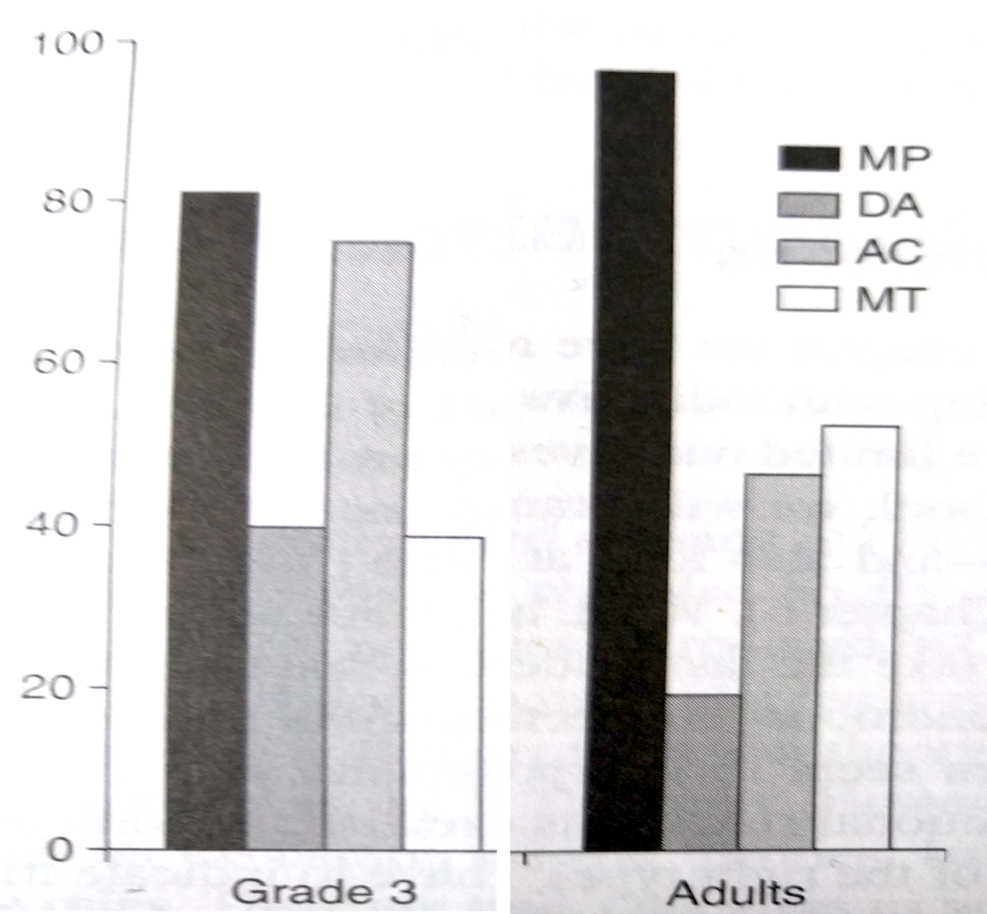
Barrouillet et al (2000)
100%
Adults are good with arguments about the ANTECEDENT
Endorsement
0%
Grade 3
Adults

Slide 37
Barrouillet et al (2000)
100%
We’re not so sure what to do when the argument pertains to the CONSEQUENT
Endorsement
0%
Grade 3
Adults

Slide 38
Barrouillet et al (2000)
100%
Kids assume that AFFIRMATORY arguments are correct?
0%
Grade 3
Adults

Slide 39
Wason’s (1968) selection task
Rule: If there is an R on one side of the card, then there is a 2 on the other
?

Slide 40
Wason’s (1968) selection task
Rule: If there is an R on one side of the card, then there is a 2 on the other
R
Does this need to be turned?

Slide 41
Wason’s (1968) selection task
Rule: If there is an R on one side of the card, then there is a 2 on the other
R
G
Does this need to be turned?

Slide 42
Wason’s (1968) selection task
Rule: If there is an R on one side of the card, then there is a 2 on the other
R
G
2
Does this need to be turned?

Slide 43
Wason’s (1968) selection task
Rule: If there is an R on one side of the card, then there is a 2 on the other
R
G
2
7
Does this need to be turned?

Slide 44
Rule: If there is an R on one side of the card, then there is a 2 on the other
R
G
2
7
ANTECEDENT
CONSEQUENT

Slide 45
If people solved the problem using deductive reasoning…
“If R then 2”
Modus ponens
Modus tollens
R
G
2
7
ANTECEDENT
CONSEQUENT
AFFIRM
DENY

Slide 46
NOPE… people use a positive test strategy*, selecting the two cards that “affirm” the rule
“If R then 2”
Modus ponens
Affirming the consequent
R
G
2
7
ANTECEDENT
CONSEQUENT
AFFIRM
AFFIRM
* More traditionally called “confirmation bias” but this terminology is misleading

Slide 47
Aside: note the similarity between adults and kids…
AFFIRM
100%
“If R then 2”
R
G
2
7
AFFIRM
AFFIRM
0%
Grade 3
Adults
… humans like positive evidence
(there’s a good reason for this, btw)

Slide 48
People are better at deontic versions of the selection task
Indicative rule
– if this then that
– “On Monday I wear black”
(Sperber & Girotto 2002)

Slide 49
People are better at deontic versions of the selection task
x
Indicative rule
– if this then that
– “On Monday I wear black”
Deontic rule
– if this then you should that
– “On Monday you MUST wear black”
(Sperber & Girotto 2002)

Slide 50
Whose ID needs to be checked?
Minor drinking SOMETHING

Slide 51
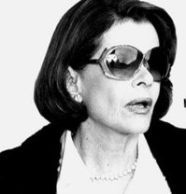
Whose ID needs to be checked?
x
Minor drinking SOMETHING
Adult drinking SOMETHING

Slide 52
Whose ID needs to be checked?
x
Minor drinking SOMETHING
Adult drinking SOMETHING
SOMEONE drinking tea

Slide 53
Whose ID needs to be checked?
x
SOMEONE drinking beer
Minor drinking SOMETHING
Adult drinking SOMETHING
SOMEONE drinking tea

Slide 54
Whose ID needs to be checked?
Minor drinking SOMETHING
Adult drinking SOMETHING
SOMEONE drinking tea
SOMEONE drinking beer
Modus ponens
Modus tollens
(Sperber & Girotto 2002)

Slide 55
Mini-summary
Logical reasoning
Definitions of deductive and inductive reasioning
Syllogisms and how they work
Definitions of valid and invalid reasoning
Four argument types: MP, MT, DA and DC
Empirical evidence
Developmental changes?
Wason selection task
Indicative vs deontic versions

Slide 56
Part 2: Inductive reasoning

Slide 57
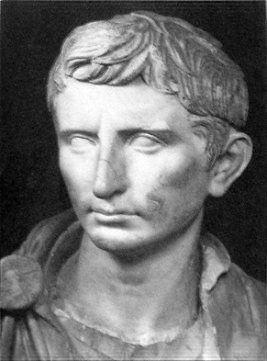
All humans are mortal?
Socrates was mortal
Aristotle was mortal
Cicero
was mortal
Augustus was mortal
Inductive arguments rely on limited evidence to make a (general or specific) conclusion seem more plausible

Slide 58
All humans are mortal?
Socrates was mortal
Aristotle was mortal
Cicero
was mortal
Augustus was mortal
All humans are white. And male? And statues?
Socrates was white
Aristotle was white
Cicero
was white
Augustus was white
It... um… doesn’t always work

Slide 59
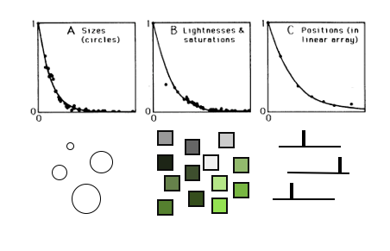

(FYI, we’ve seen inductive reasoning in the last lecture…)
“Generalising from one stimulus to another is an act of induction”

Slide 60
Inductive arguments
Dolphins express the TH4 gene
Seals express the TH4 gene
Argument strength = do the premises make the conclusion feel more believable?
Dolphins → Seals

Slide 61
Which feels stronger?
Dolphins → Seals
Dolphins → Mice

Slide 62
Dolphins → Seals
Dolphins → Mice
(Data from Tauber, Navarro, Perfors & Steyvers, in press)

Slide 63
Premise-conclusion similarity
(Osherson et al 1990)
x
Dolphins → Seals
Dolphins → Mice
People are more willing to endorse an inductive argument when the premise and conclusion items are similar

Slide 64
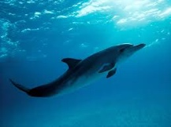

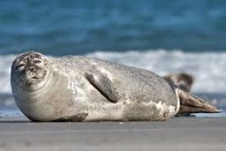
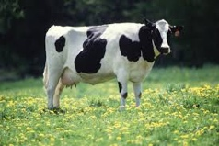

Which feels stronger?
Dolphins + Seals → Cows
Dolphins + Mice → Cows

Slide 65
Premise diversity
People are more willing to endorse an inductive argument when the premises are dissimilar
(Osherson et al 1990)
Dolphins + Seals → Cows
Dolphins + Mice → Cows
Dolphins → Mice
People are more willing to endorse an inductive argument when the premise and conclusion items are similar

Slide 66

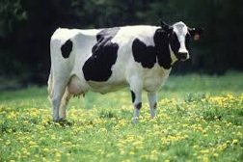


Which feels stronger?
Dolphins → Cows
Dolphins + Mice→ Cows

Slide 67
Premise monotonicity
People are more willing to make inductive generalisations when they have more examples!
(Osherson et al 1990)
Dolphins → Cows
Dolphins + Mice→ Cows
Dolphins → Mice
People are more willing to endorse an inductive argument when the premise and conclusion items are similar

Slide 68
Mini-summary
Difference between induction and deduction
Phenomena in inductive reasoning
Premise-conclusion similarity
Premise diversity
Premise monotonicity

Slide 69
Part 3: Fallacies & informal reasoning

Slide 70
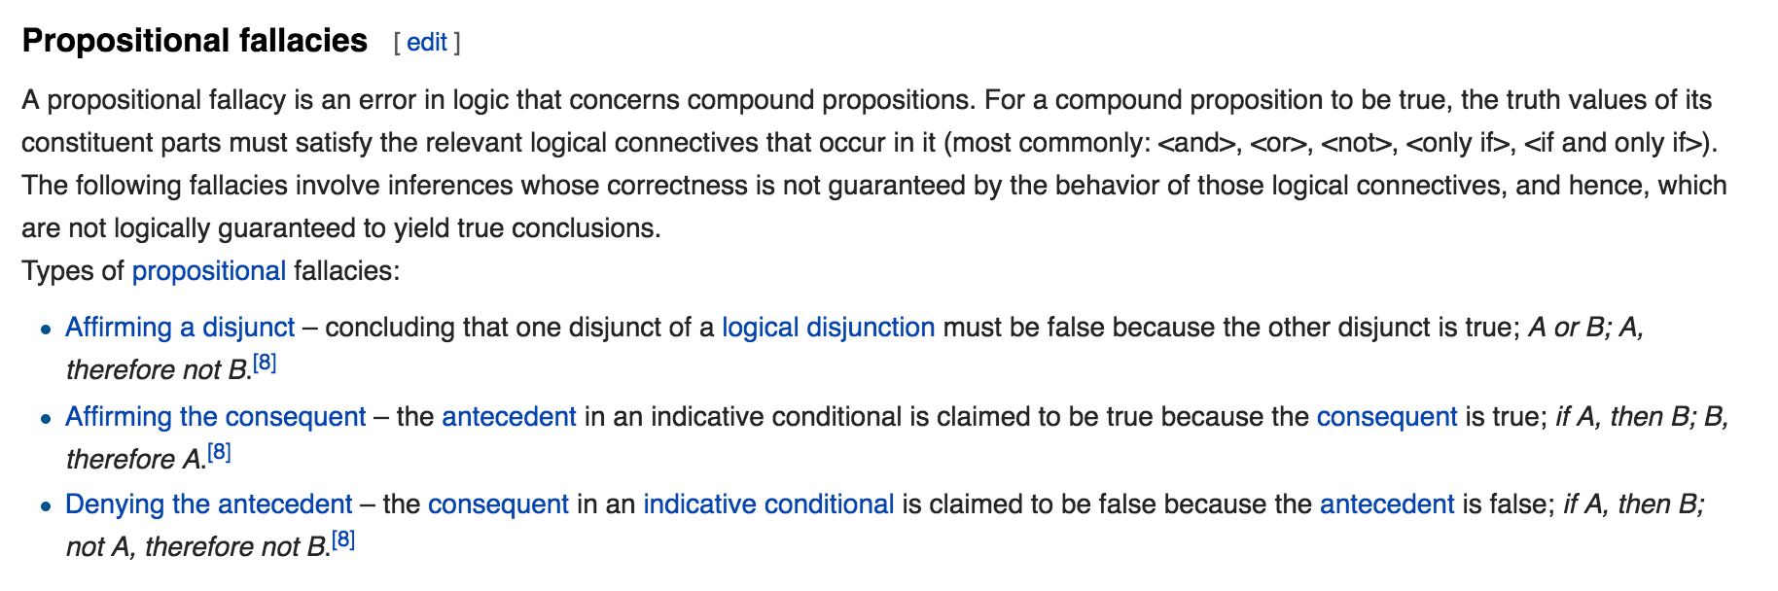
x
x
x
x
Some “reasoning fallacies” occur because people fail to follow deductive logic… as we saw earlier in the lecture

Slide 71
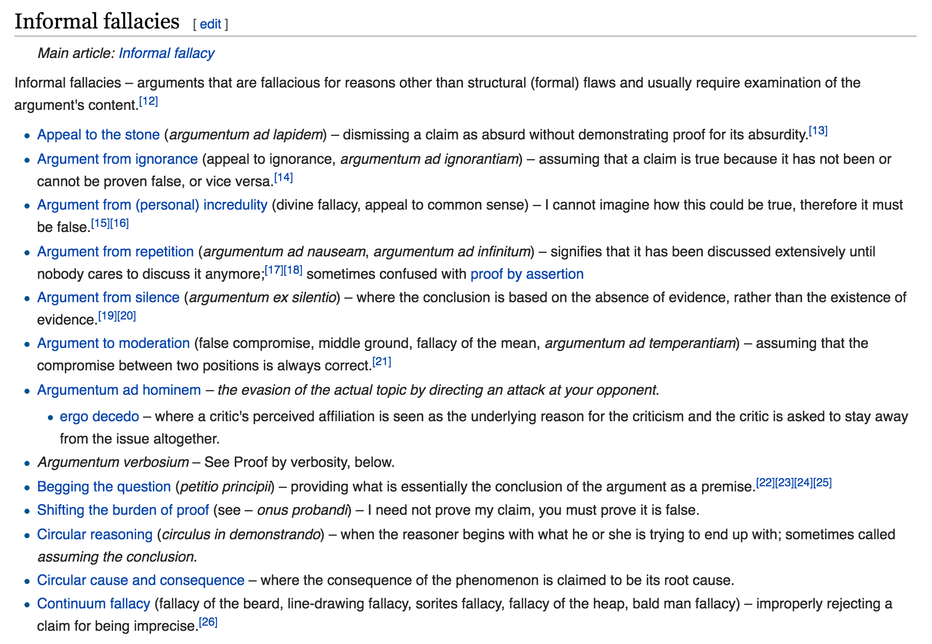
x
x
x
x
x
x
x
Other reasoning fallacies occur because there’s something not-quite-right with their content
x
x
x
x
x
x
x
x
x
x
x
x
x
x
x
x

Slide 72
x
x
x
x
x
x
x
We’ll focus on some of the empirical evidence about how these two work
x
x
x
x
x
x
x
x
x
x
x
x
x
x
x
x

Slide 73
Arguments from ignorance
“Claiming that X must be true just because you can’t prove that X is false”

Slide 74
“Ghosts exist… because there is no proof that they do not”
(Hahn & Oaksford 2007)

Slide 75
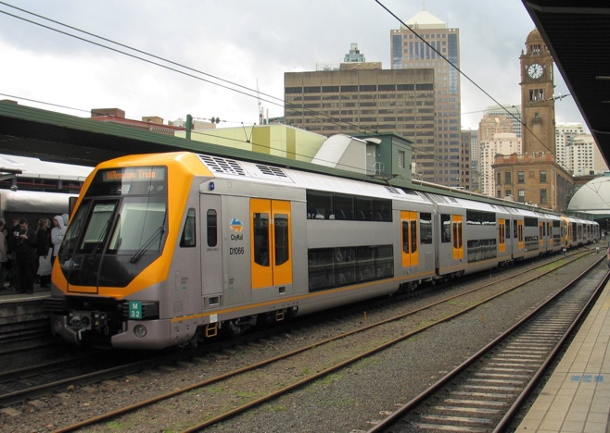
This is also an argument from ignorance
x
“There’s no Hatfield stop in Sydney … because it’s not on the Metro map”
“Ghosts exist… because there is no proof that they do not”
(Hahn & Oaksford 2007)

Slide 76
Structure of the ghosts argument
If ghosts don’t exist, there should be proof of their impossibility
There is no proof of the impossibility of ghosts
Therefore, ghosts exist

Slide 77

Structure of the trains argument
If Hatfield exists, it should be listed on the Metro map
It is not listed on the Metro map
Therefore, Hatfield does not exist

Slide 78

These are both deductively valid
If A then B
Not B
Modus tollens
Therefore, not A
A = ghosts exist
B = proof that ghosts are impossible
A = the Hatfield stop exists
B = Hatfield is listed on the Metro map

Slide 79
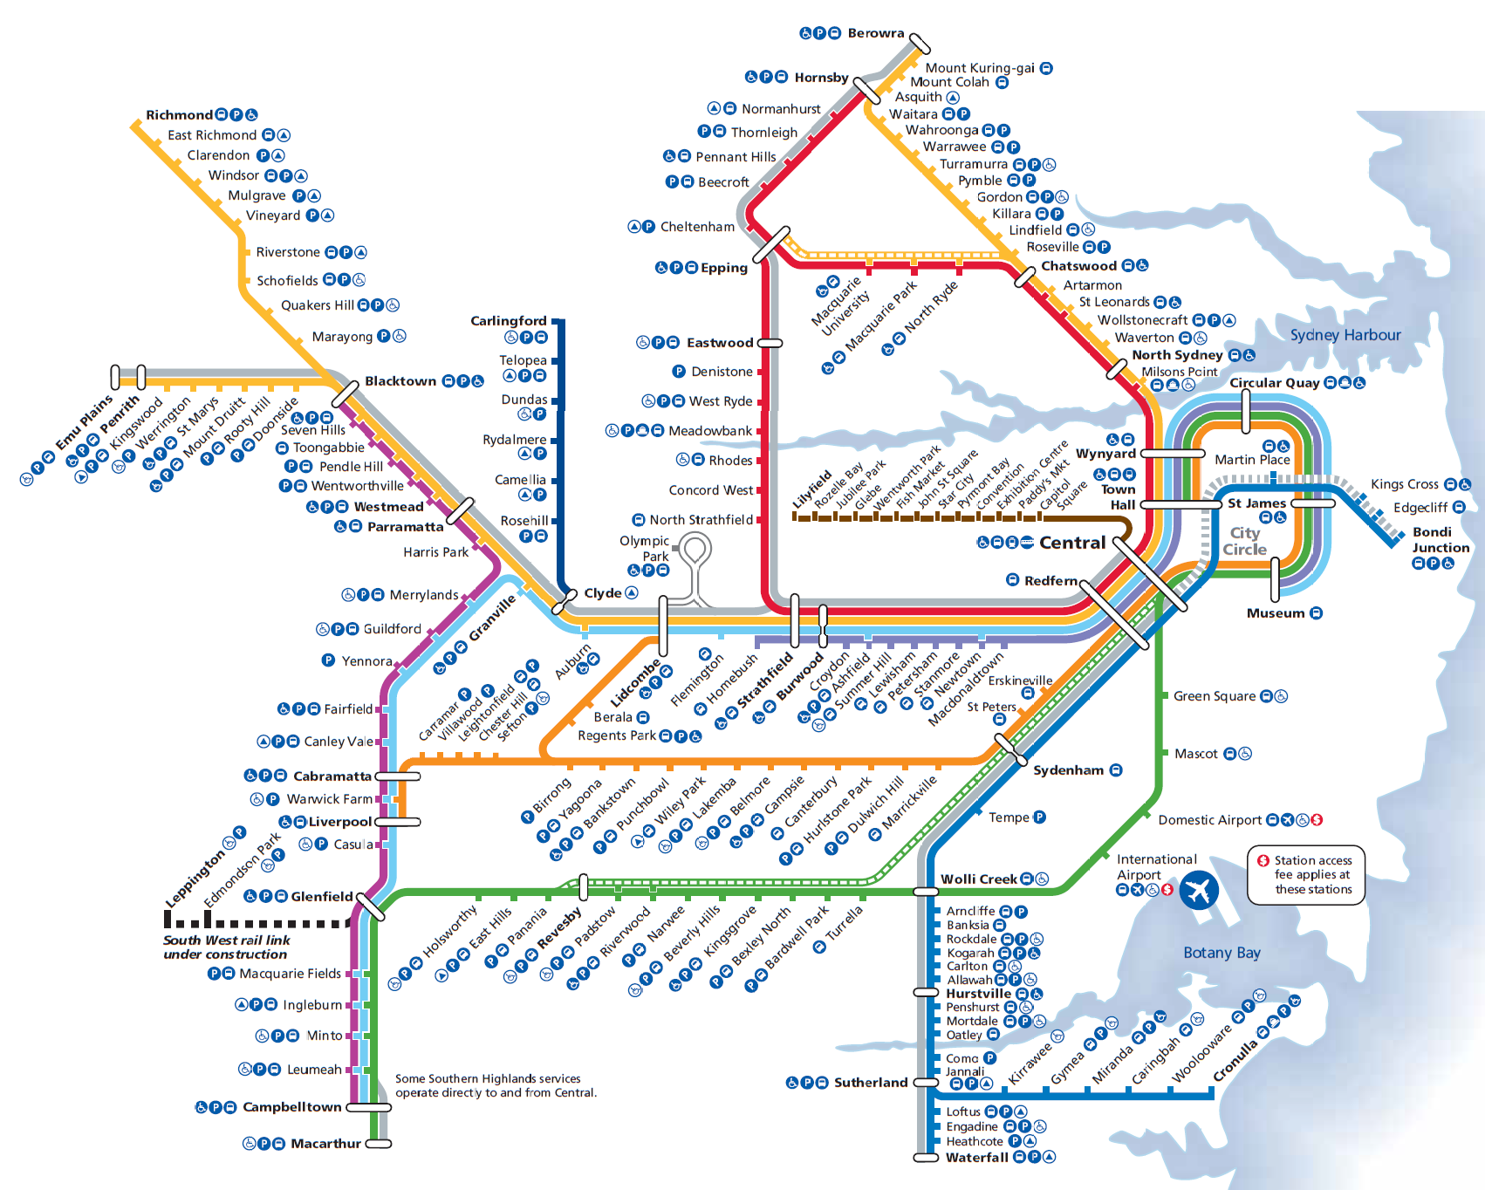
Epistemic closure (“closed world”)
The Sydney metro map is epistemically closed: it is presumed to be a complete representation of the train network
No Hatfield on the map is very strong evidence that there is no Hatfield in world

Slide 80
Epistemic closure (“closed world”)
The scientific literature on ghosts is NOT epistemically closed: there are true facts not in scientific journals!
The fact that no-one has proved ghosts impossible is not very strong evidence for the existence of ghosts

Slide 81
Another example
Jon Snow can’t remember a day when it was 50 degrees in Sydney… therefore the temperature in Sydney has never reached 50 in living memory
“Um… you’re a fictional character and basically an idiot”

Slide 82
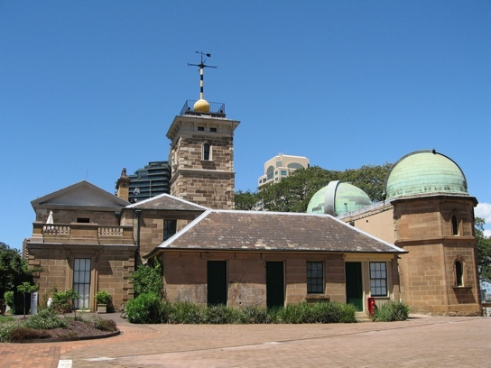
Another example
x
Jon Snow can’t remember a day when it was 50 degrees in Sydney… therefore the temperature in Sydney has never reached 50 in living memory
“Um… you’re a fictional character and basically an idiot”
The Bureau of Meteorology has never recorded a temperature of 50 degrees in Sydney … therefore the temperature in Sydney has never reached 50 in living memory
“We have extensive & detailed records of Sydney weather for over a century”

Slide 83
All the possible true facts about Sydney weather
BoM knows most true facts and is rarely wrong
You know nothing Jon Snow

Slide 84
X
If BoM doesn’t know of a 50 degree day, there probably wasn’t one
X
There’s no reason to care what Jon Snow thinks

Slide 85
Do people respect the inductive strength of an argument from ignorance?
I [strongly / weakly] believe that this drug [does / does not] have side effects because [one / fifty] experiments reported it
(Oaksford & Hahn 2004)

Slide 86
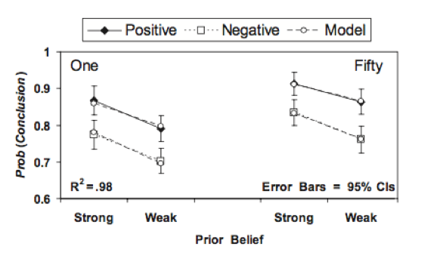
I [strongly / weakly] believe that this drug [does / does not] have side effects because [one / fifty] experiments reported it
(Oaksford & Hahn 2004)

Slide 87
I [strongly / weakly] believe that this drug [does / does not] have side effects because [one / fifty] experiments reported it
(Oaksford & Hahn 2004)

Slide 88
I [strongly / weakly] believe that this drug [does / does not] have side effects because [one / fifty] experiments reported it
(Oaksford & Hahn 2004)

Slide 89
Circular arguments
“Assuming that X is true in order to prove that X is true”

Slide 90
Circular arguments
God exists because the Bible says so, and the Bible is the word of God

Slide 91
Circular arguments
x
God exists because the Bible says so, and the Bible is the word of God
Inductive reasoning is justified because it has worked in the past, so it will work in the future

Slide 92
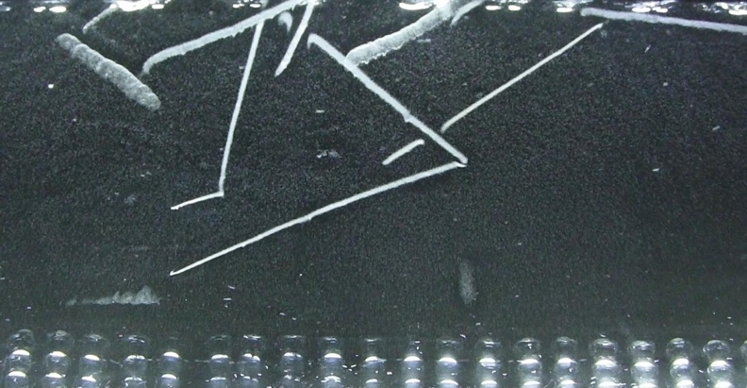
Circular arguments
x
God exists because the Bible says so, and the Bible is the word of God
Inductive reasoning is justified because it has worked in the past, so it will work in the future
Electrons exist because we can see 3-cm tracks in a cloud chamber, and 3-cm tracks in a cloud chamber are the signatures of electrons

Slide 93

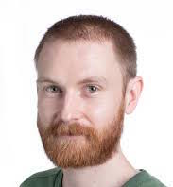
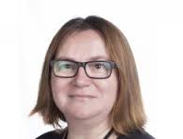
Hm.
There is a white triangle because it is blocking the black circles and the black triangle… and we assume there’s a black triangle and black circles because there’s a white triangle blocking them

Slide 94
Constraint satisfaction, simplicity … and circularity?
Layer 1
Layer 2
The simplicity and figural goodness properties of layer 1 provide evidence for the existence of layer 2, and vice versa … mutually reinforcing
⤺
⤻

Slide 95



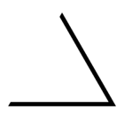
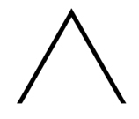
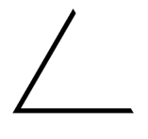
Constraint satisfaction, simplicity … and circularity?
x
Layer 1
Layer 2
The simplicity and figural goodness properties of layer 1 provide evidence for the existence of layer 2, and vice versa … mutually reinforcing
⤺
⤻
One layer with 6 strange shapes?
I suppose this is possible but if that’s the best alternative hypothesis I’m going to go with the circular one!

Slide 96

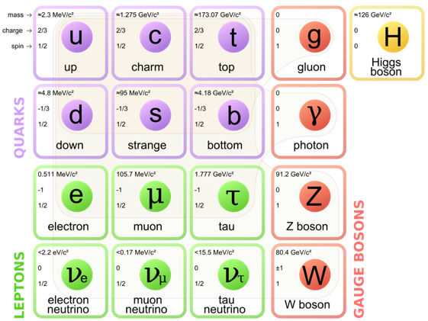
Circular arguments are often an implicit appeal to an explanatory “system”
Christianity ⇒ God + Bible
Physics ⇒ Experiments + Theory
⤺
⤻
⤺
⤻
The subjective “strength” of circular arguments depends on how strongly you accept the “system” as an explanation for a larger body of facts

Slide 97
Hahn & Oaksford (2007)
John: I think there’s a thunderstorm
Anne: What makes you think that?
John: I just heard a loud noise that could have been thunder
Anne: That could have been an airplane
John: I think it was thunder, because I think it’s a thunderstorm
Anne: Well, it has been really muggy around here today

Slide 98
Hahn & Oaksford (2007)
John: I think there’s a thunderstorm
Anne: What makes you think that?
John: I just heard a loud noise that could have been thunder
Anne: That could have been an airplane
John: I think it was thunder, because I think it’s a thunderstorm
Anne: Well, it has been really muggy around here today
Alternative is low plausibility:
“John and Anne are in their camper
van at their woodland campsite”
Alternative is high plausibility:
“John and Anne are in their trailer
home near the airport”

Slide 99
People rate John’s circular argument as more convincing when the alternative explanation is less plausible
Alternative is low plausibility:
“John and Anne are in their camper
van at their woodland campsite”
Alternative is high plausibility:
“John and Anne are in their trailer
home near the airport”

Slide 100
Mini-summary
“Rational” explanations of fallacies?
Examples:
Argument from ignorance (epistemic closure)
Circular arguments (appeal to explanatory system)

Slide 101
It is by no means easy to decide just what is meant by reason
- William James (1890)

Slide 102


It is by no means easy to decide just what is meant by reason
- William James (1890)
When is an “inductive inference” warranted and when is it silly?
When is “argument from ignorance” a fallacy and when it it wise?
→
Are people really doing the selection task “wrong”?
R
G
2
7

Slide 103
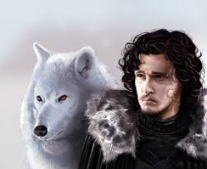
Let it snow!

